Slide 1
Compiler Design (CS363IA)
Title: GenAI-Powered Pull Request Descriptions with OpenMP Spec Integration(#Issue-35)
USN | NAME
1RV23CS407 | MANOJ KUMAR B V
1RV23CS410 | NAGAPRASAD NAIK

Slide 2
INTRODUCTION
In modern software development, clear and comprehensive pull request (PR) descriptions are essential for effective code review and collaboration—especially in large-scale projects like LLVM’s OpenMP runtime. However, writing meaningful PR summaries is often time-consuming and inconsistent. This project introduces a Clang-compatible Command-Line Interface (CLI) tool that leverages Generative AI (GenAI) to automatically generate structured and informative pull request descriptions. By combining Code diffs from GitHub PRs, Specific information extracted from the OpenMP Specification, and LLM-based summarization (via Groq's LLaMA3-70B model).

Slide 3
PROBLEM STATEMENT
Writing clear and detailed pull request (PR) descriptions for OpenMP in the LLVM project takes a lot of time and often lacks consistency. Developers need a simple way to automatically create good PR summaries that also follow the OpenMP specification.

Slide 4
OBJECTIVES
Build a Clang CLI tool to automatically generate structured PR descriptions.
Use code diffs and OpenMP spec content to create accurate summaries.
Integrate Generative AI to write clear and informative descriptions.
Make it easy for developers to get spec-aware PR summaries with just a PR number.
.

Slide 5
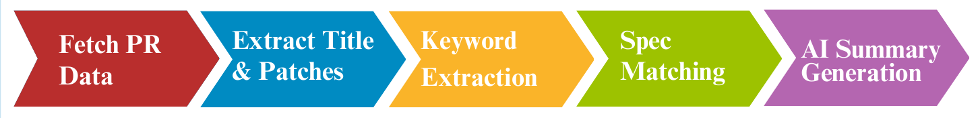
METHODOLOGY
Fetch PR Data: Retrieve pull request title, changed files, and code diffs from GitHub using the PR number.
Extract Title & Patches: Loads the patches and PR title.
Keyword Extraction: Keywords are extracted from both the PR title and code patch. These keywords help to locate relevant OpenMP sections.
Spec Section Matching: Each line of the specification PDF is scanned to match extracted keywords and returns the matched specification section.
AI Summary Generation: Used a GenAI model (LLaMA3-70B) to generate a structured PR description using the patch and matched specification section.

Slide 6
LIMITATIONS
API Rate Limitation : Groq (or other LLM APIs) have usage limits based on the number of requests and tokens consumed
LLM Token/Context Limit : The language model (e.g., LLaMA3-70B) has a context length limit (~8,192 tokens).
Keyword-Based Section Matching : This may lead to inaccurate or generic section references when keywords are ambiguous or sparse.

Slide 7
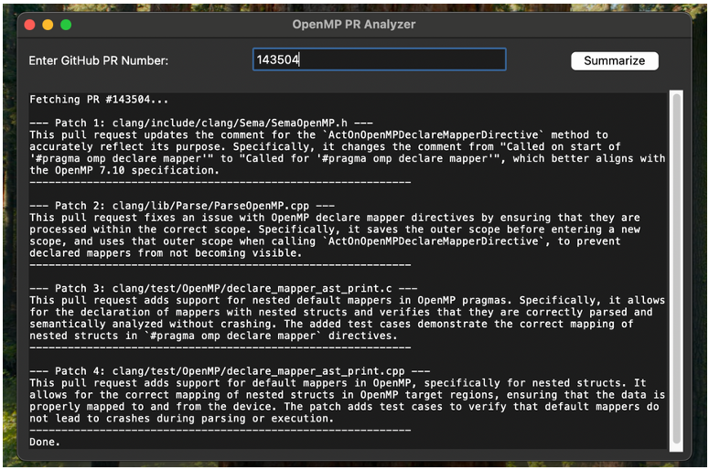
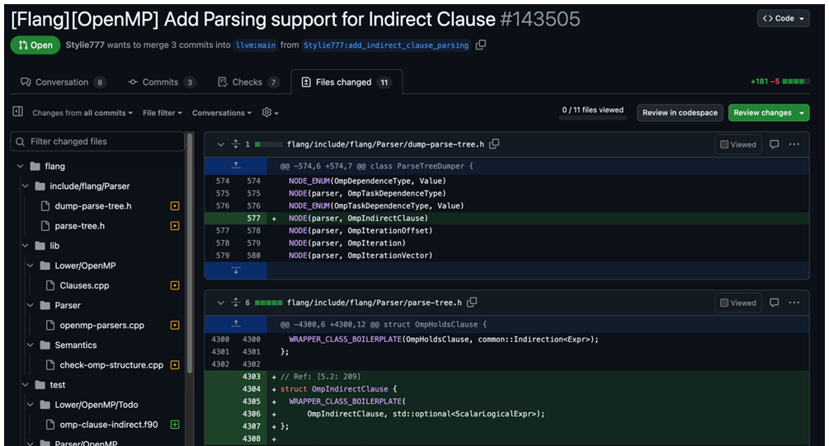
RESULT

Slide 8
CONCLUSION
The tool was tested on real OpenMP pull requests from the LLVM repository. It generated accurate, context-rich summaries by combining code diffs with the correct OpenMP spec sections. With Groq’s LLaMA3-70B model, summaries were produced, helping developers write better PR descriptions faster. This project shows that Generative AI can automate PR documentation effectively, saving time, improving accuracy, and making code reviews clearer and more compliant with the OpenMP standard.

Slide 9
THANK YOU

